Slide 1
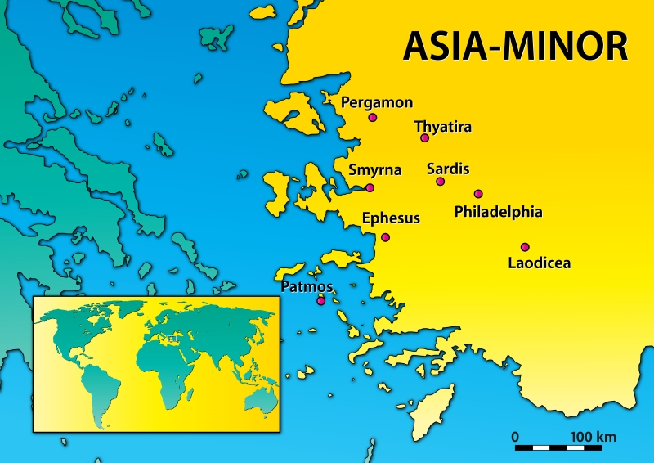
Letters to the 7 Churches
Lenten Lunch – 4/5/2022
This Photo by Unknown Author is licensed under CC BY-NC

Slide 2
What do we know about Philadelphia?
Ben Franklin?
Philly Cheesesteak?
Independence Hall?
How many faithful churches??

Slide 3
What do we know about Philadelphia?
This Photo by Unknown Author is licensed under CC BY-SA

Slide 4
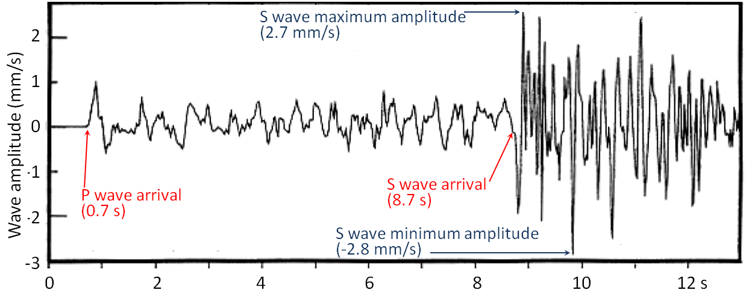
Letter to the Church in Philadelphia
This Photo by Unknown Author is licensed under CC BY
The city of “Brotherly Love”
Located about 28 miles southeast of Sardis
Local volcanos led to many earthquakes but a very fertile plateau
The city was destroyed by a major earthquake in a.d. 17

Slide 5
To the Church in Philadelphia
⁷“And to the angel of the church in Philadelphia write: ‘The words of the holy one, the true one, who has the key of David, who opens and no one will shut, who shuts and no one opens. ⁸“‘I know your works. Behold, I have set before you an open door, which no one is able to shut. I know that you have but little power, and yet you have kept my word and have not denied my name. ⁹Behold, I will make those of the synagogue of Satan who say that they are Jews and are not, but lie—behold, I will make them come and bow down before your feet, and they will learn that I have loved you. ¹⁰Because you have kept my word about patient endurance, I will keep you from the hour of trial that is coming on the whole world, to try those who dwell on the earth. ¹¹I am coming soon. Hold fast what you have, so that no one may seize your crown. ¹²The one who conquers, I will make him a pillar in the temple of my God. Never shall he go out of it, and I will write on him the name of my God, and the name of the city of my God, the new Jerusalem, which comes down from my God out of heaven, and my own new name. ¹³He who has an ear, let him hear what the Spirit says to the churches.’
ESV Bibles. ESV Prayer Bible (p. 2934). Crossway. Kindle Edition.

Slide 6
Gold on the Surface
Does the self-designation of the Risen, Ascended Christ remind God’s people of the Lord’s revelation given elsewhere?
Is there any condemnation in this letter?
Why is “Behold!” such a great word in the Bible?
What are the promises given to this church of “little power”?

Slide 7
Digging Deeper
An Open Door & the Key of David
What happens to those of “the synagogue of Satan”?
What are the promises to these steadfast believers?

Slide 8
Moving Forward by Faith!
Do we ever struggle with self-doubt? When and Why?
What open doors are before us? How does this direct our mission?
How can we warn people that when the door is shut that no one can open it? How might this affect our message or urgency in proclaiming the Gospel?

